Slide 1


Customer Retention & Dynamic Pricing Analysis
Hospitality Analytics | Machine Learning | Power BI Dashboard

Slide 2




Executive Problem Statement
Revenue Leakage
Hotels experience major revenue leakage due to booking cancellations and inefficient pricing strategies
Traditional Systems Limitations
Cannot accurately forecast cancellations or optimize room pricing dynamically
Our Solution
Uses analytics and machine learning to improve customer retention and revenue management
Data-Driven Hospitality Solutions

Slide 3







Business Objectives
Reduce Customer Cancellation Rates
Minimize revenue loss from booking cancellations
Improve Customer Retention Strategies
Enhance loyalty and repeat bookings
5 Core Objectives
Driving Business Growth
Optimize Revenue Per Available Room (RevPAR)
Maximize revenue from available inventory
Strategic Goals
Understand Seasonal Booking Trends
Revenue Optimization
Identify and capitalize on demand patterns
Customer Satisfaction
Operational Efficiency
Support Data-Driven Pricing Decisions
Enable strategic pricing optimization

Slide 4







Dataset & Technologies
Advanced Tools
Exploratory Data Analysis
Dataset
Matplotlib & Seaborn
Hotel Booking Demand Dataset
Machine Learning
Core Technologies
Scikit-learn
Interactive Dashboards
Python
Pandas
NumPy
Power BI
Total Tools
Categories
6
3

Slide 5







Data Cleaning & Preprocessing
1
Handled Missing Values & Duplicates
Data quality assurance
2
Converted Date & Categorical Columns
Data type optimization
5-Step Process
Data Preparation Pipeline
3
Performed Feature Engineering
New variable creation
Data Quality
Completeness
100%
4
Encoded Customer & Booking Categories
Numerical representation
Consistency
100%
Accuracy
100%
5
Prepared Dataset for ML Modeling
Ready for analysis

Slide 6







Exploratory Data Analysis
Long Lead Times
Higher cancellation probability
Corporate Customers
Stronger retention patterns
5 Key Insights
Data-Driven Discoveries
Peak Seasons
ADR increased significantly
Analysis Coverage
Booking Patterns
Weekend Pricing
Customer Behavior
Improved hotel profitability
Revenue Trends
Pricing Dynamics
Online TA
Highest booking volume

Slide 7





Machine Learning Models
Classification Models
3 ML Models
Logistic Regression
Prediction Capabilities
Binary Classification
Probability Output
Cancellation Prediction
Estimate booking cancellation probability
Decision Tree Classifier
Interpretable
Non-Linear
Dynamic Pricing Support
Optimize room rates based on predictions
Random Forest Classifier
Ensemble Method
High Accuracy
Accuracy
Models
85%+
3

Slide 8

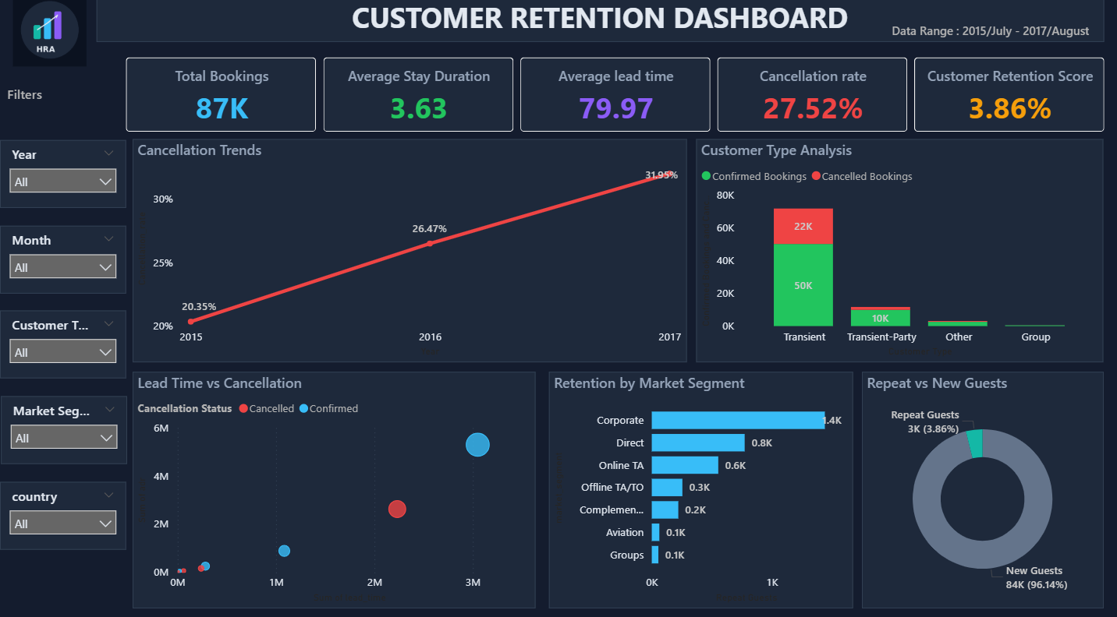





Customer Retention Dashboard
July 2015 - August 2017
Total Bookings
87K
Avg Stay
3.63days
Avg Lead Time
79.97
Cancellation Rate
27.52%
Retention Score
3.86

Slide 9






Customer Retention Dashboard Key Insights
Cancellation Rate Increased Yearly
Rising trend from 20.35% to 31.95% over the period
Transient Customers Dominated Bookings
4 Key Insights
Highest volume with 50K confirmed and 22K cancelled
Dashboard Analysis
Corporate Customers Showed Better Retention
31.95%
Highest Cancellation Rate
Stronger loyalty patterns compared to other segments
Customer Segments
Repeat Guests Contributed a Smaller Share
New Guests
84K (96.14%)
Corporate
1.4K
New guests account for 96.14% of bookings

Slide 10

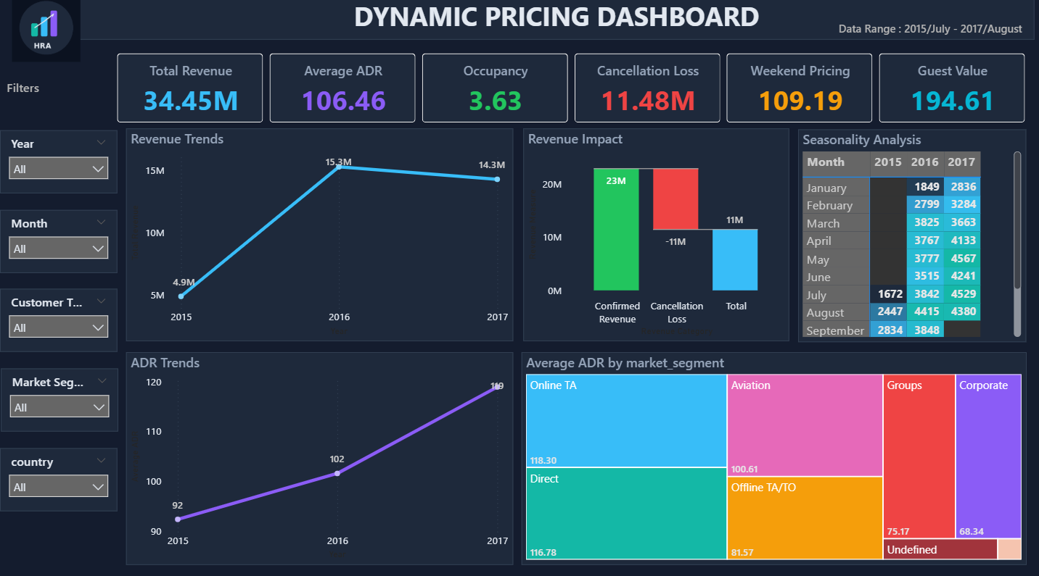





Dynamic Pricing Dashboard
Revenue & ADR Analysis
Total Revenue
34.45M
Average ADR
106.46
Revenue Growth
+192%
Peak Season
14.3M
ADR Trend
Growth

Slide 11





Dynamic Pricing Dashboard Key Insights
Revenue Peaked During High-Demand Periods
Peak revenue reached $14.3M in high-demand seasons
4 Key Insights
ADR Increased Across Years
Pricing Analysis
Average Daily Rate showed consistent growth trend
Total Revenue Growth
+192%
Weekend Pricing Improved Profitability
$4.9M → $14.3M (2015-2017)
Higher weekend rates contributed to better margins
Pricing Performance
Cancellation Loss Significantly Impacted Revenue
Average ADR
$106.46
Peak Season ADR
Highest
Revenue leakage from cancelled bookings

Slide 12







Business Recommendations
Implement Loyalty & Retention Programs
Enhance customer engagement and repeat bookings
Apply Predictive Cancellation Alerts
Proactively manage at-risk bookings
5 Strategic Actions
Use Dynamic Seasonal Pricing
Implementation Roadmap
Adjust rates based on demand patterns
Expected Impact
Increase ADR During High-Demand Periods
Revenue Growth
+15-20%
Maximize revenue during peak seasons
Retention Rate
+10%
ADR Optimization
+8%
Improve Forecasting with ML Models
Enhance prediction accuracy for better decisions

Slide 13






Future Enhancements
Real-Time Pricing Engine
Dynamic pricing adjustments based on live market data
Advanced Demand Forecasting
Multi-factor predictive models for accurate demand planning
5 Future Plans
Deep Learning-Based Churn Prediction
Innovation Roadmap
Neural networks for advanced customer churn analysis
Implementation Phase
Integration with Live Booking Systems
Short-Term
6 months
Real-time data synchronization with hotel PMS
Medium-Term
1 year
Long-Term
2 years
Automated Recommendation Engine
AI-driven suggestions for pricing and operations

Slide 14



Conclusion
Analytics Improves Revenue Management
Data-driven approach optimizes hotel operations and profitability
Project Success
Interactive Dashboards Provide Insights
Key Achievements
Actionable business intelligence for informed decision-making
Impact Metrics
Revenue Growth
+192%
Machine Learning Enhances Decisions
Prediction Accuracy
85%+
Advanced algorithms support customer retention and dynamic pricing
Decision Support
Real-time

Slide 15



Thank You
For Your Attention & Time
Questions Welcome
|
Let's Connect

